Slide 1
Natural selection
IGCSE Biology

Slide 2
Definiton
Natural selection-
the greater chance of passing on of genes by the best-adapted organisms
Selection pressure-
an environmental factor that causes organisms with certain characteristics to have a better chance of survival than others

Slide 3
Natural selection theory (6 points)
Variation in individuals
Over-production
Struggle for existence/ competition
Survival of the fittest
Advantageous characteristics passed on to offspring
Gradual change of features in the population (better adapted to environment)

Slide 4
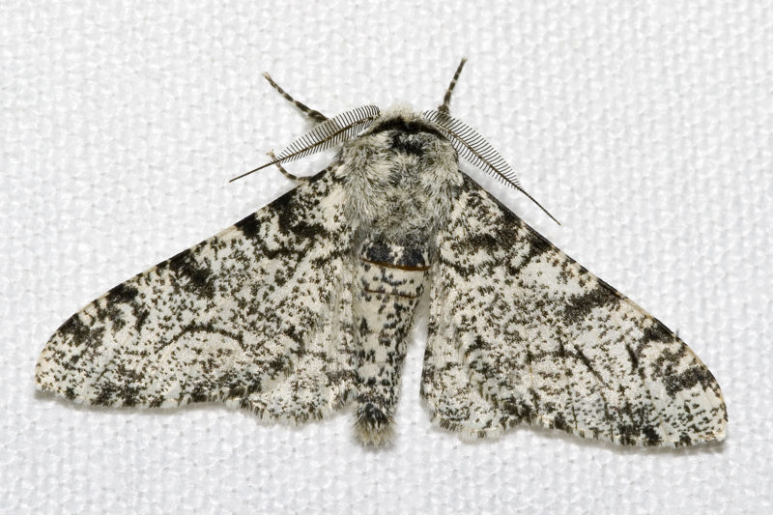
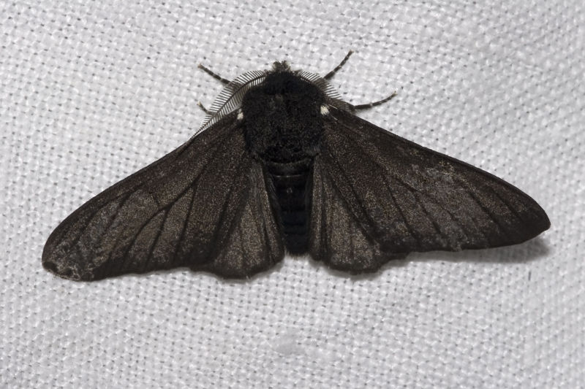
Natural selection example 1
One well known example of natural selection is the peppered moth (Biston betularia) which is found all over Britain.
The moth spends daytime resting on tree trunks.
Speckled form
Black/ melanic form

Slide 5
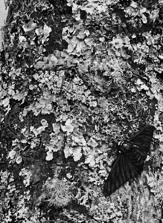
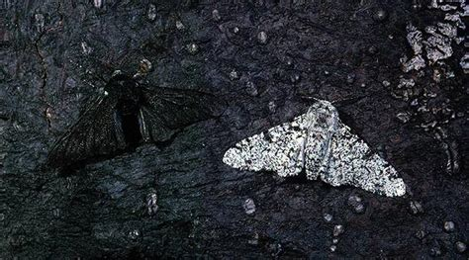
Natural selection example 1
Tree bark covered by lichen (algae living among filaments of fungi species)

Slide 6
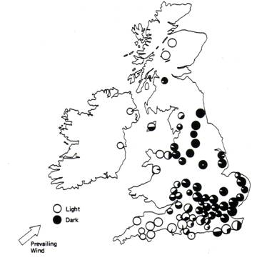
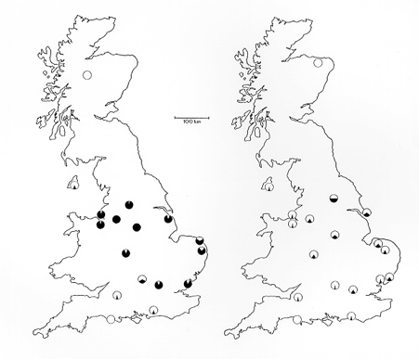
distribution change
What happened?
1998
1956
prevailing wind
Notes:
The prevailing wind in a region of the Earth's surface is a surface wind that blows predominantly from a particular direction.

Slide 7
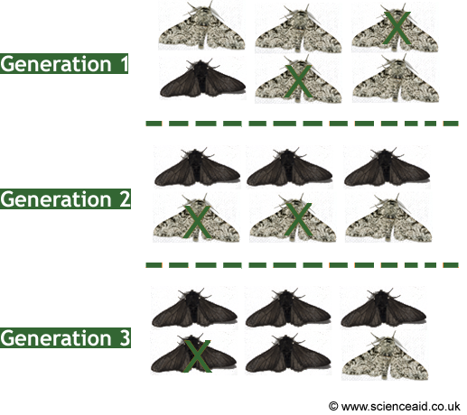

Slide 8
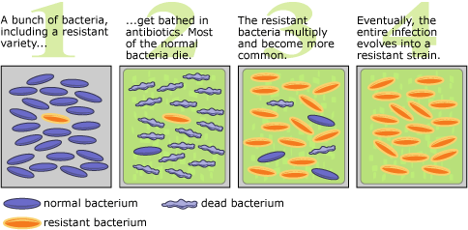
Natural selection example 2

Slide 9
sickle cell anaemia
sickle cell anaemia
malaria

Slide 10
Natural selection
In the same way, new types of mosquito have evolved which are resistant to the insecticide, DDT, and rats now exist that are resistant to the rat-poison warfarin.
These new forms have a big advantage, and so are able to spread quickly.

Slide 11
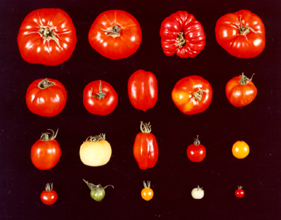
Artificial selection
Compare artificial selection and natural selection.
Q: Do you think artificial selection is natural selection?

Slide 12
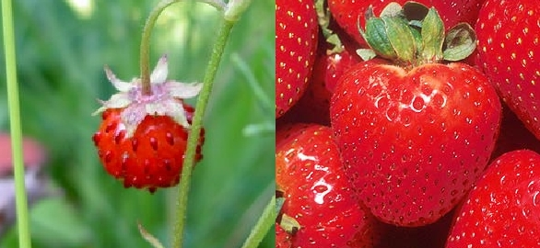
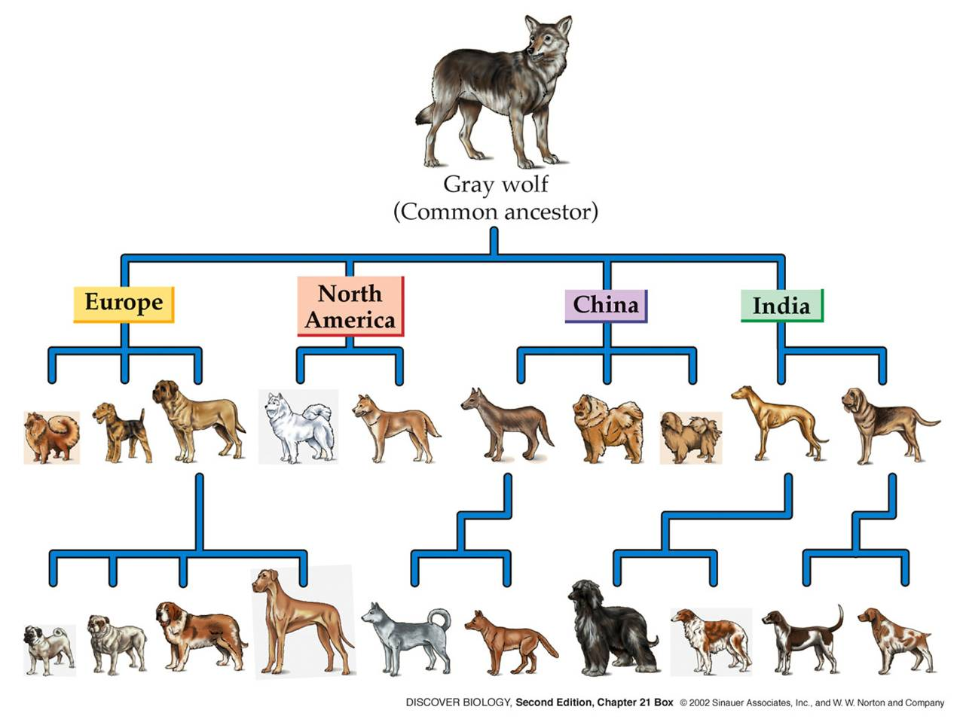
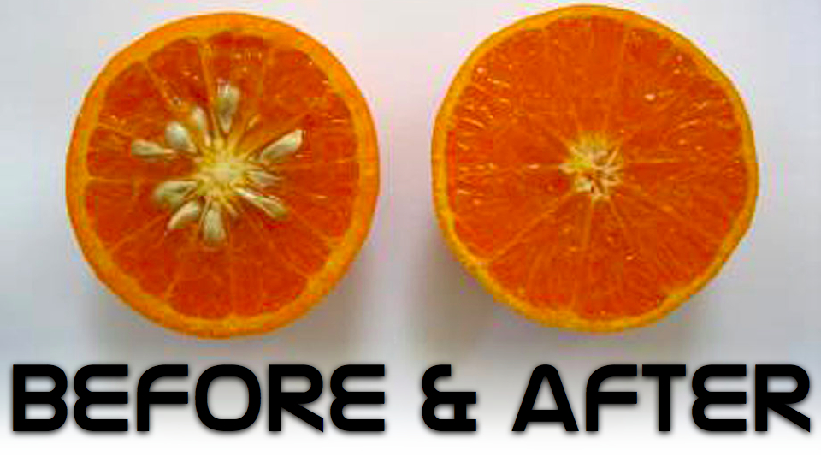
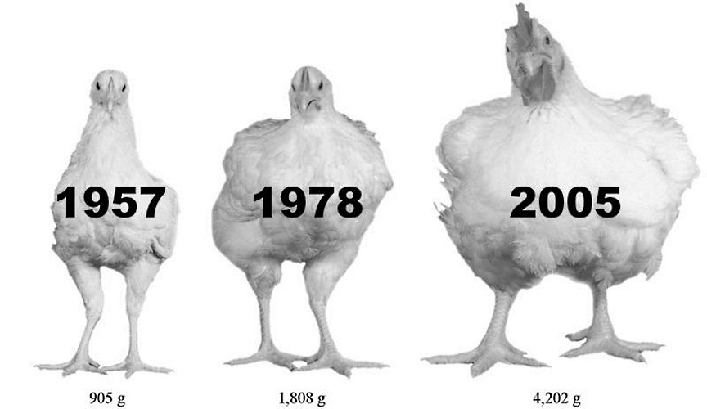

Slide 13
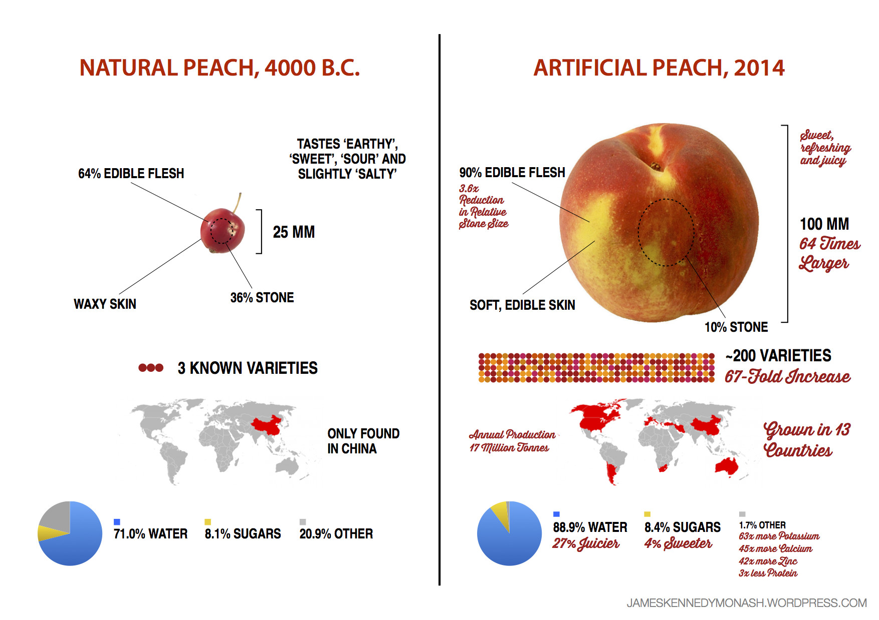

Slide 14
